Slide 1

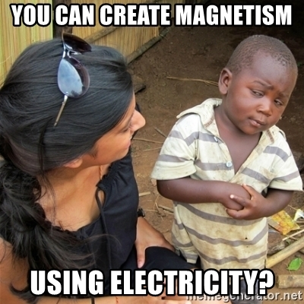
Magnetism and electricity day 1
9-22 & 9-23

Slide 2
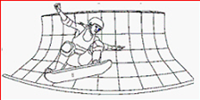
DQ
Two students decided to use their knowledge about non-contact forces to build a hoverboard park. They embedded thousands of bar magnets into the surface of the floor with the north poles facing up
What would the polarity of the bottom of the hoverboard have to be in order to levitate the board, and what kind of non-contact force would this demonstrate?
A. ---The bottom of the hoverboard would have to be a south pole. ---This would demonstrate gravity.
B. ---The bottom of the hoverboard would have to be a north pole. ---This would demonstrate magnetism.
STND: 8PS2.1
STND: 8PS2.1 & 8ETS1.1

Slide 3
1. Check textbook page
2. Share posters
3. Revise initial model and share with your lab group
STND: 8PS2.1
STND: 8PS2.1 & 8ETS1.1

Slide 4
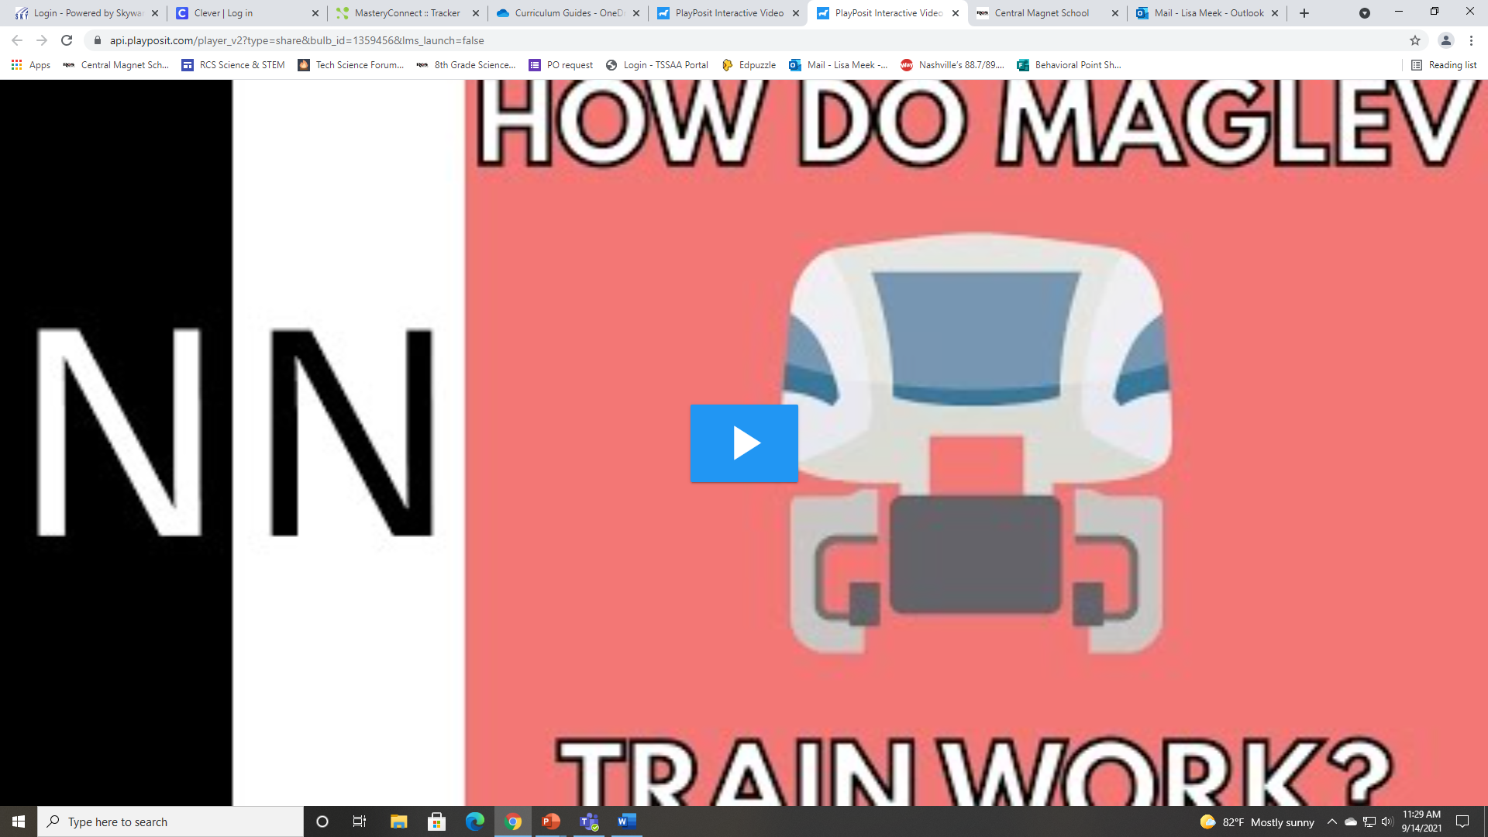
How does a maglev train work?
STND: 8PS2.1
STND: 8PS2.1 & 8ETS1.1

Slide 5
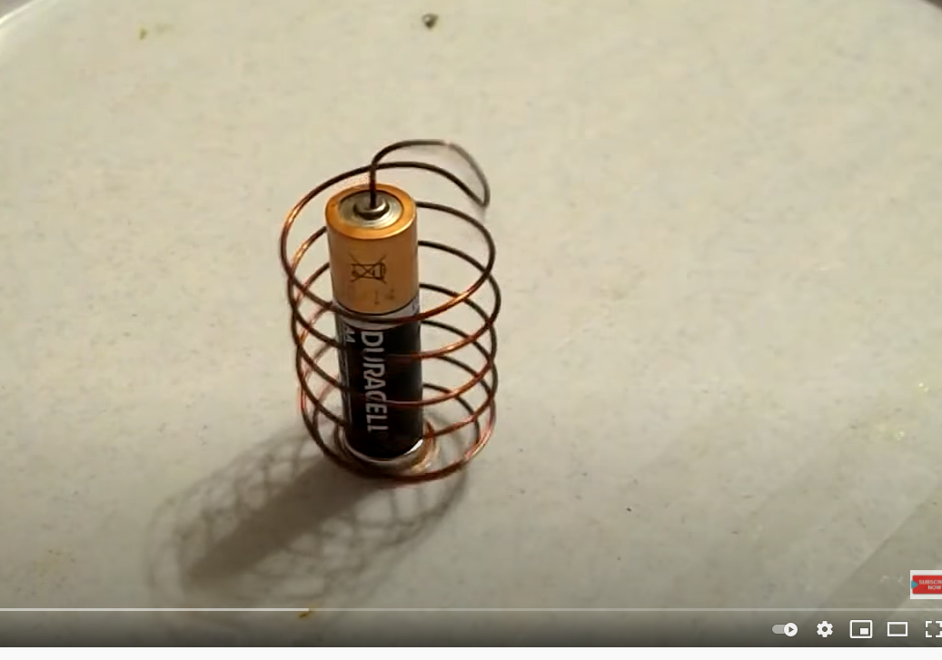
Homopolar Motor Phenomenon
Watch the video and right down questions and observations to help your group come up with a driving question.
Develop an initial model to answer the driving question: How does a homopolar motor work without gasoline?
STND: 8PS2.1
STND: 8PS2.1 & 8ETS1.1

Slide 6
Create a homopolar motor with your lab group
Materials:
AA battery
Copper wire
Neodymium magnet (this is a very strong magnet. Do not place it near your phone or computer.)
After you make a successful homopolar motor, revise your initial model
STND: 8PS2.1
STND: 8PS2.1 & 8ETS1.1

Slide 7
Watch the following videos about magnetism and take notes
Khan Academy: Magnetism
Magnetism: Crash Course Physics #32
STND: 8PS2.1
STND: 8PS2.1 & 8ETS1.1

Slide 8
Exit Ticket
Electrical motors convert electrical energy into what type of energy?
STND: 8PS2.1
STND: 8PS2.1 & 8ETS1.1

